Slide 1
Predicting Parkinson With Handwriting
By Joshua Wilson

Slide 2
What's new / goals
Worked on models
Compared the strengths of variables
Compared Models

Slide 3
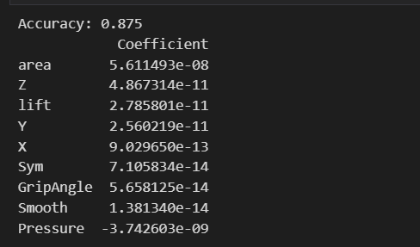
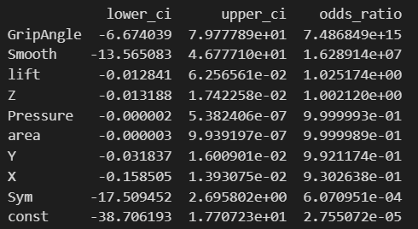
Variables
Based of the regression test and the hypothesis test I was able to determine that the best variables to use for my models

Slide 4
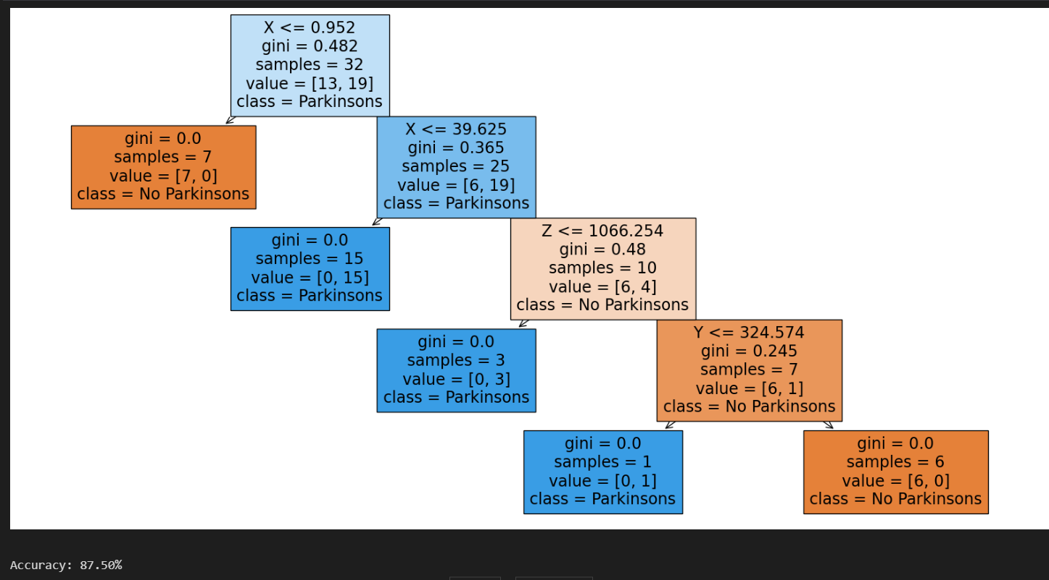
Decision Tree
Decision Tree using all
Variables

Slide 5
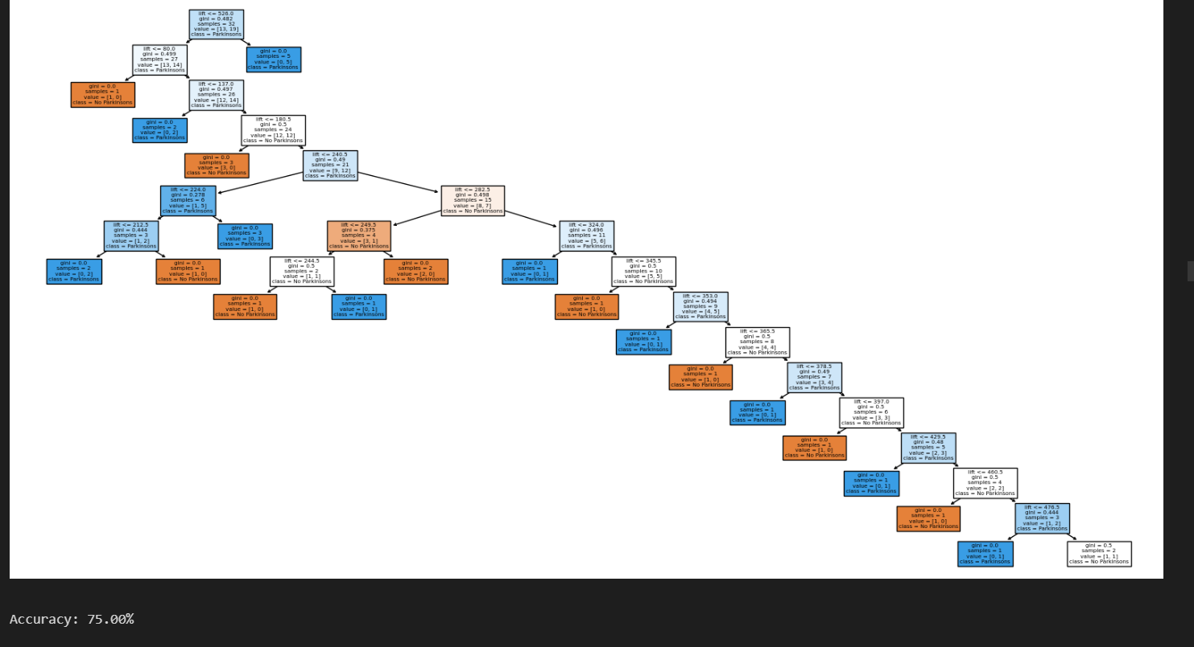
Lift Decision Tree
Using only the
Lift variable the
Decision tree was
Able to predict
With 75%

Slide 6
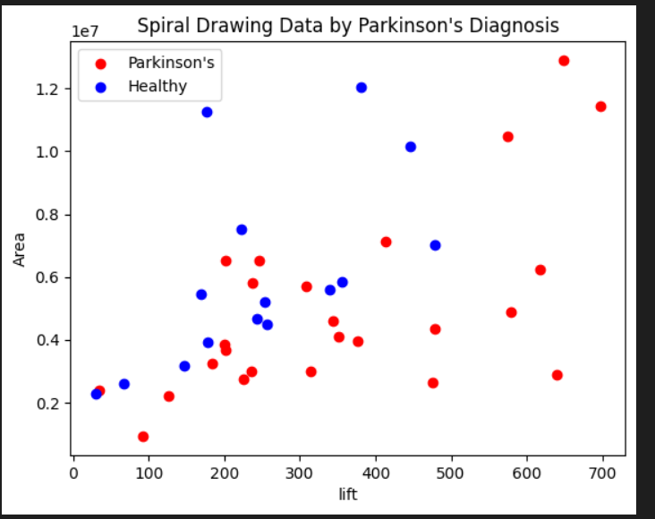
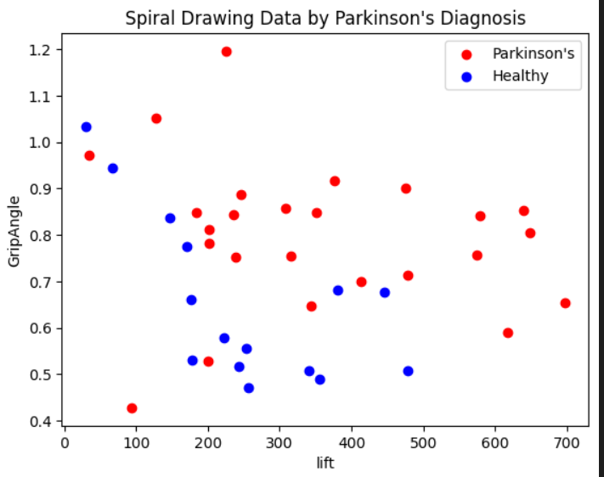
K-Means Clustering

Slide 7
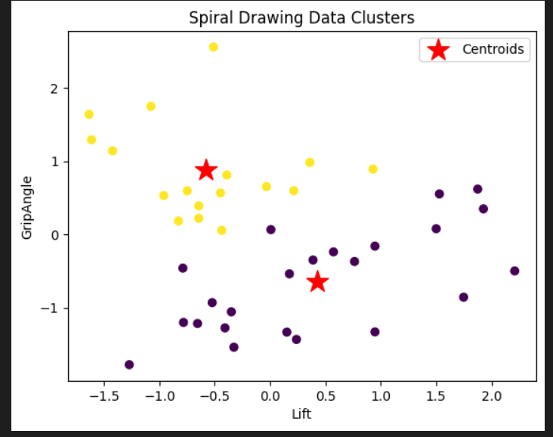
Using the mean distance for the two variables

Slide 8
Analysis
Based on these models I was able to extract important information about variables and their strength.
Such as how with every 1 unit change in lift would result in 2.5% increase in chance of parkinson's
(1.025174 - 1) x 100= 2.5174%
I was also able to determine that the other variables with the best strengths are Gripangle and smoothness
Based on the decision trees I was able to determine the quality of the variables based on their gini number
In the K-means clustering analysis I was able to compare different variables to each other in comparison to healthy and Parkinsons patients.

Slide 9
Goals
For next week I would like to test out more models such as implementing a neural network
I would also like to work more on the clustering to increase accuracy

